Slide 1
CAV Microsimulation – Modeling the Latest Research
Rob Bostrom, CDM
June 5, 2019
Notes:
Comments from Ken in Notes section of slides.

Slide 2
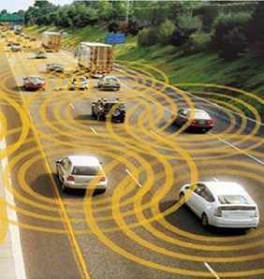
Presentation Summary
CAV Big Picture
Ohio DOT Corridor Studies
Insights from ODOT Lit Review
CAV Penetration Rates
Impacts of CAV Technologies on TDM
CAV Traffic Simulation
Literature Sources
Source: WSP
Notes:
The presentation summary is more important than the actual organization of the report for ODOT, particularly since it is not publicly available.

Slide 3
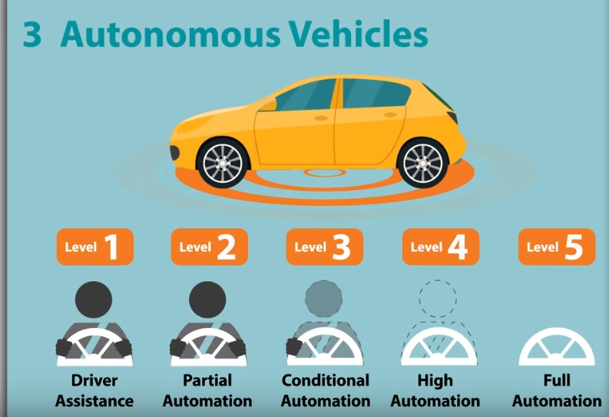
Big Picture of CAVs
Connected and Automated Vehicles (CAVs) technologies
CAVs have the potential to be disruptive and transformational.
More than 17 shared AV pilots in 8 states underway with safety “driver” (e.g. level 3 or 4)
Private ownership versus shared AVs will affect future implementation
Notes:
Needed CAV definition in first line. Added a private vs shared bullet. Combined safety driver with the pilots bullet to save space.

Slide 4
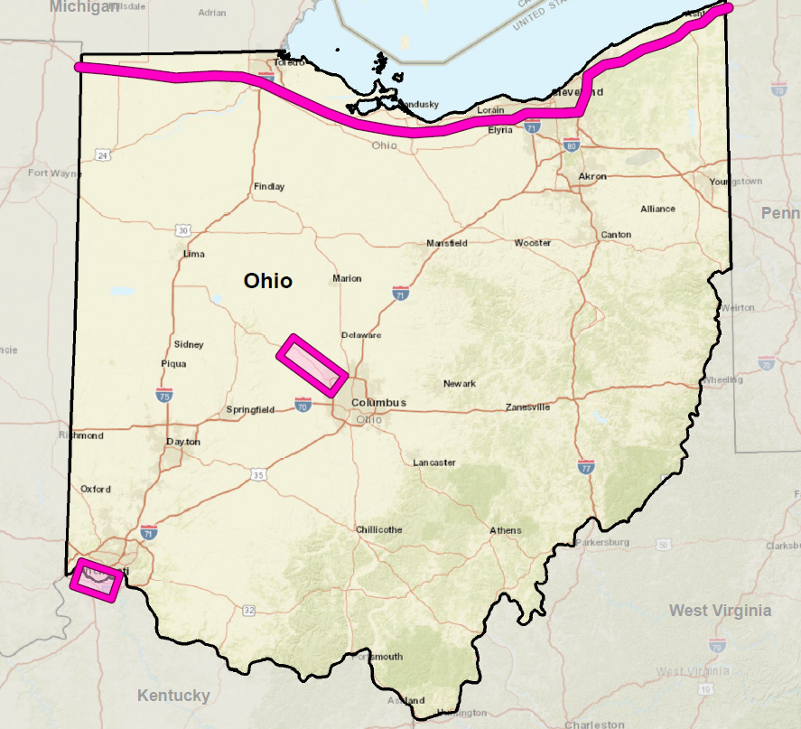
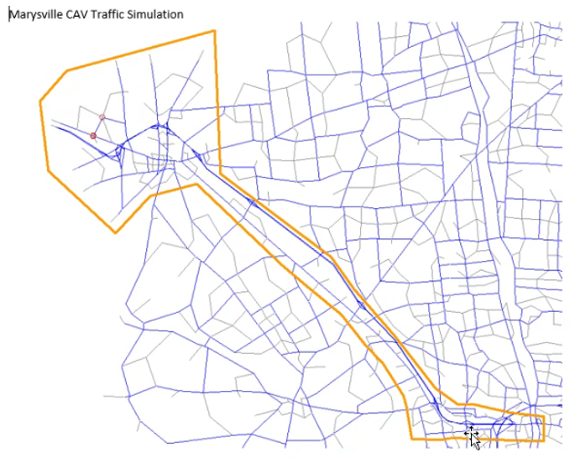
Ohio Corridor Studies – Statewide and Marysville

Slide 5
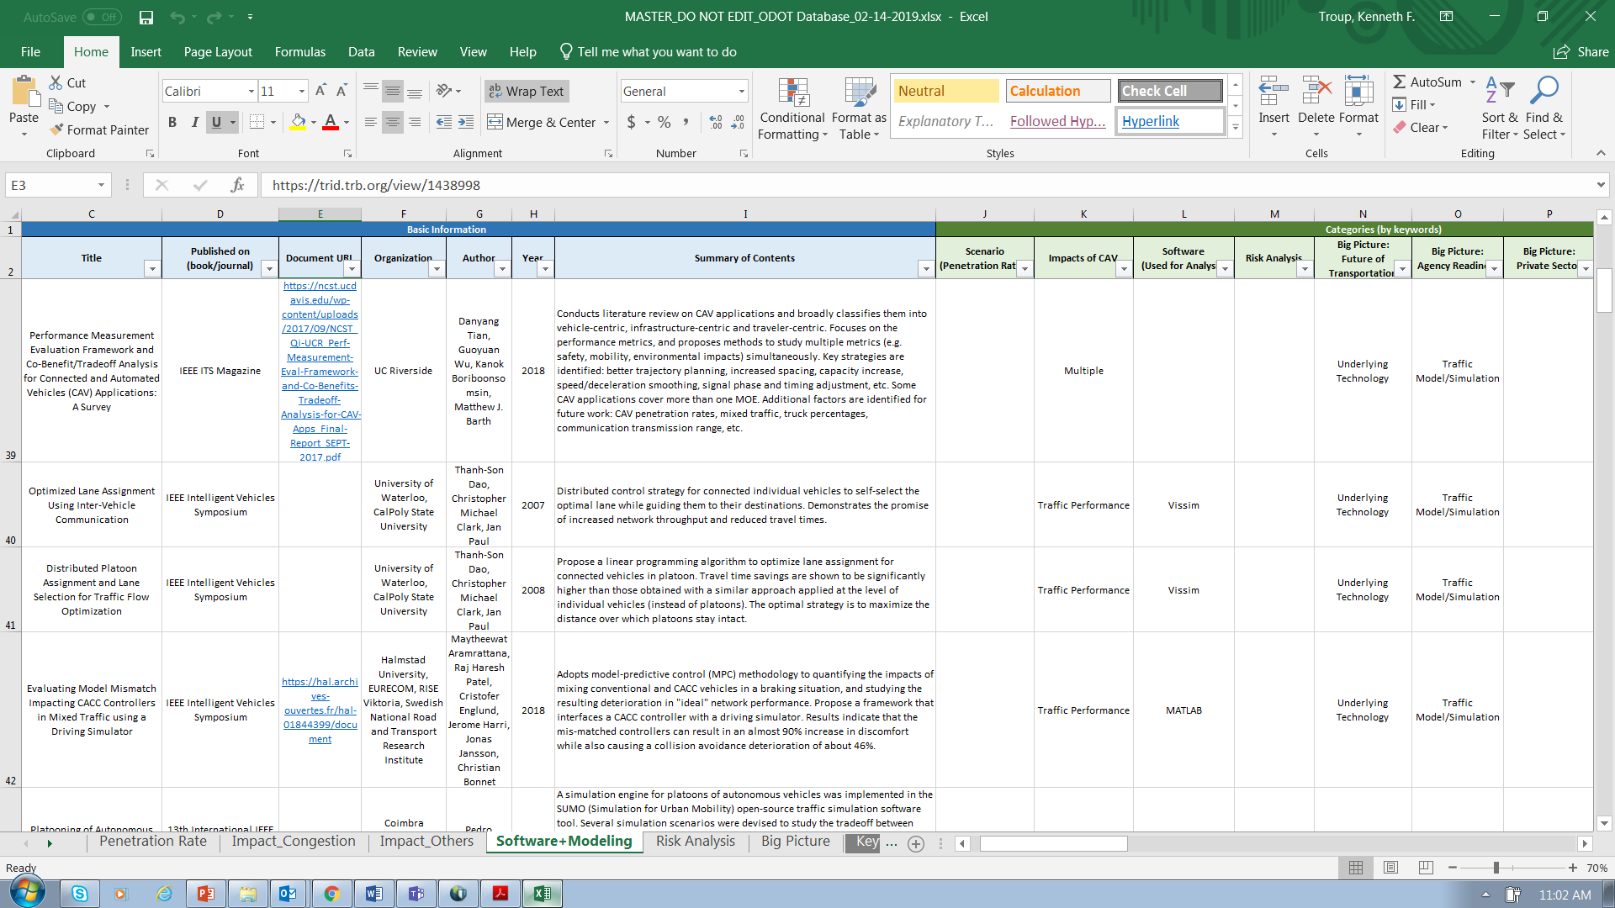
Insights from ODOT Literature Review
Unrealistically high expectations by the media
Gradual rollout and even more gradual market penetration of AVs are expected
CAV analysis is speculative and uncertain.
To address the uncertainty of CAVs implementation rates multiple scenarios will be analyzed
Notes:
Changed title from Lessons Learned to “insights” and added ODOT to the title. Moved this slide forward since the bullets set the stage for other slides that follow.

Slide 6
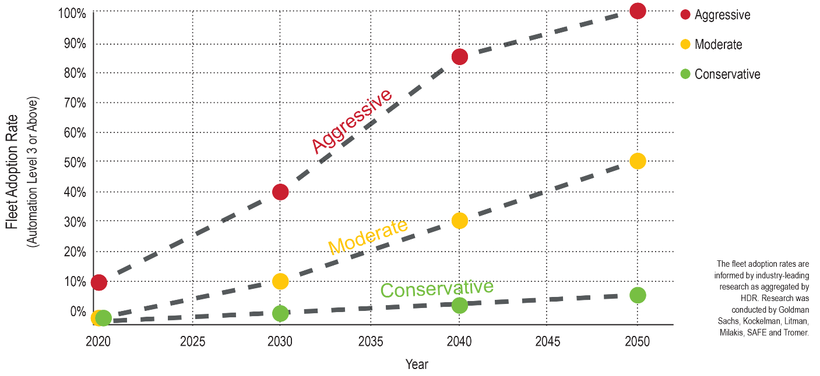
CAV Penetration Rates
Uncertainties related to penetration rates (% CAV in use)
Pace of technological maturity
Rate of inclusion of technology in new vehicles and retirement of old vehicles
Extent of use of technology by consumers
Notes:
I put the graphic along the bottom because it is less readable when scrunched on the side. The text on the lower right is unreadable and we could delete that if you wish.

Slide 7
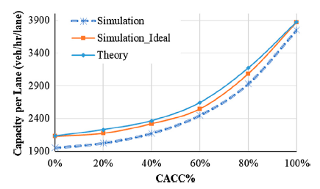
Travel Demand Modeling
Travel Demand Models can be enhanced to handle most CAV uncertainties.
Models help understand range of futures and potential policies.
CAV treated as a mode.
Numerous efforts and practical tests of TDM. The Ohio TDM will be based on the 3C models developed by ODOT and WSP.

Slide 8
Traffic Simulation Modeling
Simulations can be set up so that the market penetration level is an adjustable parameter.
The simulation allows better testing of such key measures as capacity, car following and the interaction of CAVs and the existing traffic.
Ohio DOT using Vissim and TransModeler as basis for simulating traffic.
Developing use cases and recommended model adjustments
Parameter Ranges
Source: HDR
Notes:
Included a graphic from the March presentation to show a simulation in action.

Slide 9
TFResource wiki
On line resource created by TRB committee ADB45.
Provides information and insights into needed adaptations of existing transportation planning models http://tfresource.org/Content_Charrette:_Autonomous_Vehicles
Will be updated by CDM Smith for Ohio DOT
Identified potential model changes and improvements; highlighted state applications of models http://tfresource.org/Autonomous_vehicles:_Modeling_frameworks
Notes:
Adjusted the font size of some of the bullets and links for consistency.

Slide 10
Contact Information
Rob Bostrom, CDM Smith, Bostromnr@cdmsmith.com, mobile: 859.312.2232
Ken Troup, CDM Smith, troupkf@cdmsmith.com, mobile: 978.866.6893
QUESTIONS?
Notes:
Corrected my mobile phone number.

